Slide 1

Pennant Technologies Private Limited
VIEWS in SQL

Slide 4
VIEWS Introduction
A database is a collection of tables storing some meaningful data.
All the tables are connected with some form of relation.
But the fundamental question that arises here is that why do we need to create so many tables and not just a single table.
Multiple Tables allow storing large amounts of data in a systematic manner, rather than repeating the same data in a single table.
But, we cannot deny the fact that if we want to query some data from this database, we need to bring all relevant tables together to make a new table.
So, if we observe this issue closely, we have the advantage of storing data in multiple tables on one side, but on the other side, we have the problem of querying so scattered data.
The solution to this problem brings “SQL Views” into the picture.

Slide 5
VIEWS
SQL Views have made managing data and tables relatively easy for users.
Views are virtual tables, i.e., they don’t exist in reality in the database, hence don’t require any storage in a database.
Virtual Tables also have rows and columns similar to a real table in a database.
Such views are simply made by selecting data(fields) from one or more tables, present in the database, with some conditions for selecting rows of the table.
A view is a virtual table whose contents are defined by a query. Like a table, a view consists of a set of named columns and rows of data.
Unless indexed, a view does not exist as a stored set of data values in a database.
The rows and columns of data come from tables referenced in the query defining the view and are produced dynamically when the view is referenced.
A view acts as a filter on the underlying tables referenced in the view.

Slide 6
VIEWS
The query that defines the view can be from one or more tables or from other views in the current or other databases.
Distributed queries can also be used to define views that use data from multiple heterogeneous sources.
This is useful, for example, if you want to combine similarly structured data from different servers, each of which stores data for a different region of your organization.
Views are generally used to focus, simplify, and customize the perception each user has of the database.
Views can be used as security mechanisms by letting users access data through the view, without granting the users permissions to directly access the underlying base tables of the view.
Views can be used to provide a backward compatible interface to emulate a table that used to exist but whose schema has changed.
Views can also be used when you copy data to and from SQL Server to improve performance and to partition data.

Slide 7
Uses of Views (Perks)
Views were introduced to reduce the complexity of the multiple tables and deliver data in a simple manner.
Views hide the complexity of the data in the database as they join and simplify multiple tables into a single virtual table, which is easier for a user to understand.
Being a virtual table, views take very little storage since the database contains only a view's statements (definition) and not a copy of all the tables the view is creating.
For example, even if we create multiple views, it still won’t take much space compared to a single real table in the database.

Slide 8
Uses of Views (Perks)
Views provide security to the data, acting as a security mechanism.
Let’s take a simple scenario, in an IT company, the engineer, the HR, and the manager might be using the same table for some information.
But because of their different departments, some data must be irrelevant to HR but relevant to the manager.
If so, shouldn’t there be a security mechanism that would hide irrelevant information of the table from HR? Yes, views allow us to mask/show some data of the table depending on requirements and security.
With the help of conditions, we can hide some data for a particular person.

Slide 9
Uses of Views (Perks)
We can easily update the rows in the virtual tables (views) as the DBMS translates our request through the views.
For example, let’s assume that while you are working in a company, you made a view to query some data for a product to be visible on a website.
Later, you remember you forgot to add some rows that the client required. You can easily use the update feature to add those rows to your views in such a situation.
Views also maintain data integrity as it presents a consistent and accurate image of the data from the database even if the underlying source is restructured, renamed, or split.
It can automatically check the data which a user or any other third party is trying to access meets the conditions mentioned in the views to maintain accuracy while displaying data.

Slide 10
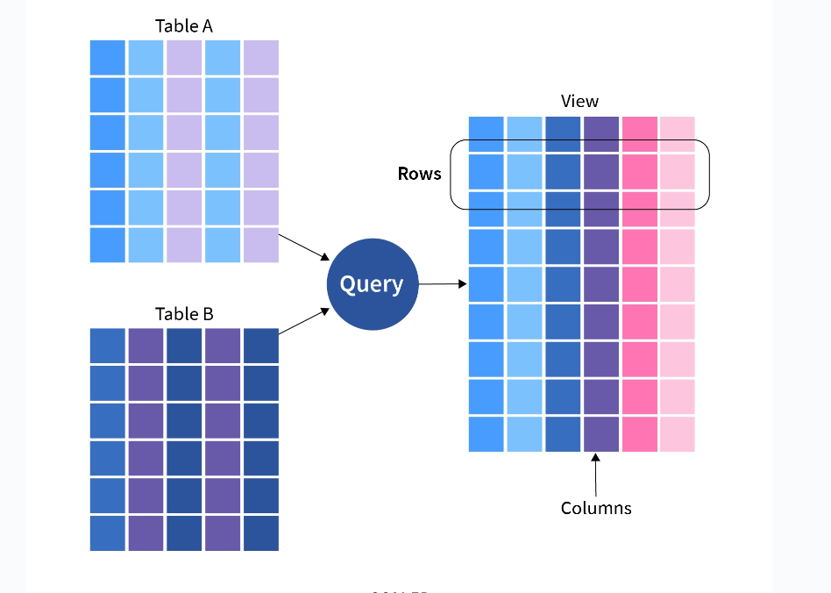

Slide 11
Views act as a proxy or virtual table created from the original table.
Views simplify SQL queries and allow secure access to underlying tables.
Views in DBMS can be visualized as virtual tables that are formed by original tables from the database.
As you can see from the above image, we can extract data columns from more than one table by running queries on the data tables.
Views contain only the definition of the view data in the data dictionary, not the actual data.
The view has two primary purposes:
Simplifying complex SQL queries.
Restricting users from accessing sensitive data.

Slide 12
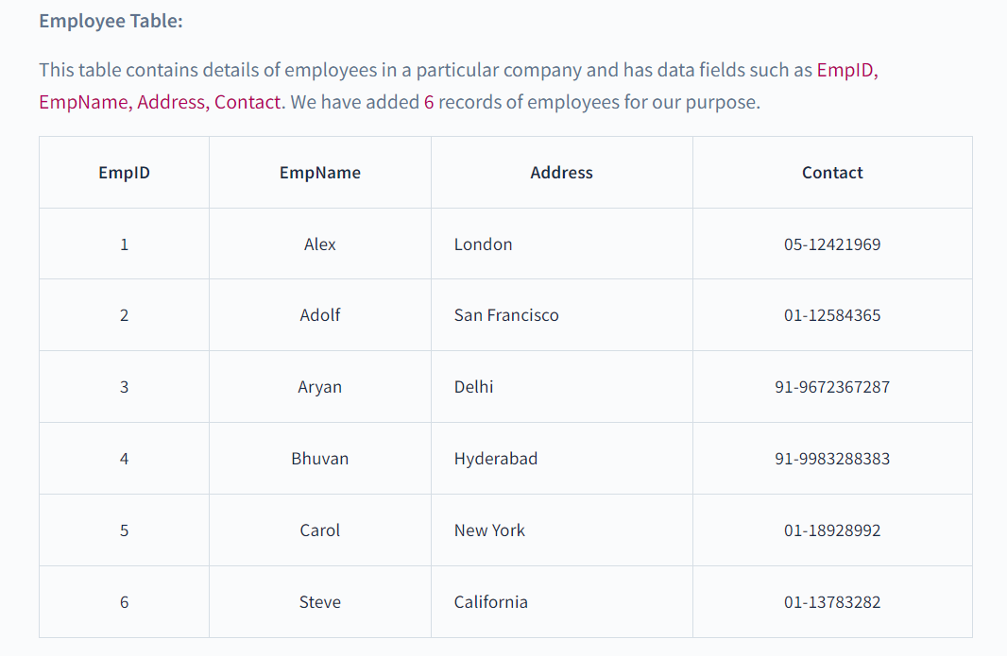
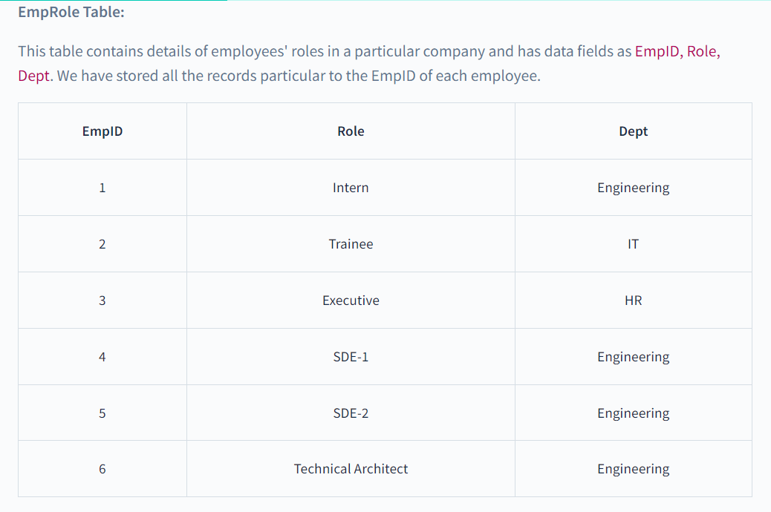

Slide 13
Creating View in DBMS
The view can be created by using the CREATE VIEW statement, Views can be simple or complex depending on their usage.
Syntax: CREATE VIEW veiwName AS
SELECT column1, column2,.... FROM tableName WHERE condition;
Here, viewName is the Name for the View we set, tableName is the Name of the table and condition is the Condition by which we select rows.
Creating a Simple View:
Simple view is the view that is made from a single table, It takes only one table and just the conditions, It also does not take any inbuilt SQL functions like AVG(), MIN(), MAX() etc, or GROUP BY clause.
While creating a simple view, we are not creating an actual table, we are just projecting the data from the original table to create a view table.
Let's look at some examples for creating a simple view.

Slide 14
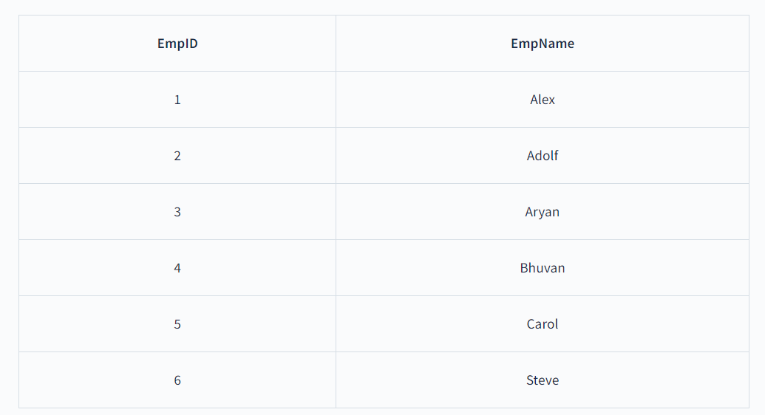
Examples
In this example, we are creating a view table from Employee Table for getting the EmpID and EmpName. So the query will be:
CREATE VIEW EmpView1 AS
SELECT EmpID, EmpName
FROM Employee;
Now to see the data in the EmpView1 view created by us, We have to simply use the SELECT statement.
SELECT * from EmpView1;
Output:
The view table EmpView1 that we have created from Employee Table contains EmpID and EmpName as its data fields.

Slide 15
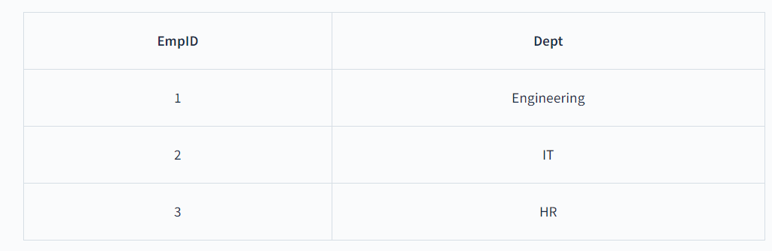
Example
In this example, we are creating a view table from EmpRole Table for getting the EmpID and Dept for employees having EmpIDs less than 4. So the query will be:
CREATE VIEW EmpView2 AS
SELECT EmpID, Dept FROM EmpRole WHERE EmpID<4;
Now to see the data in the EmpView2 view created by us, We have to simply use the SELECT statement.
SELECT * from EmpView2;
Output: The view table EmpView2 that we have created from EmpRole Table contains EmpID and Dept as its data fields.

Slide 16
Creating a Complex View
The complex view is the view that is made from multiple tables, It takes multiple tables in which data is accessed using joins or cross products, It contains inbuilt SQL functions like AVG(), MIN(), MAX() etc, or GROUP BY clause. So, whenever we need to access data from multiple tables we can make use of Complex Views.
Let's look at some examples for creating the complex view.
Example:
In this example, we are creating a view table using Employee Table and EmpDept table for getting the EmpName from the Employee table and Dept from EmpDept. So the query will be:
CREATE VIEW CompView AS
SELECT Employee.EmpName, EmpRole.Dept FROM Employee, EmpRole WHERE Employee.EmpID = EmpRole.EmpID;
Now to see the data in the EmpView1 view created by us, We have to simply use the SELECT statement.
SELECT * from CompView;

Slide 17
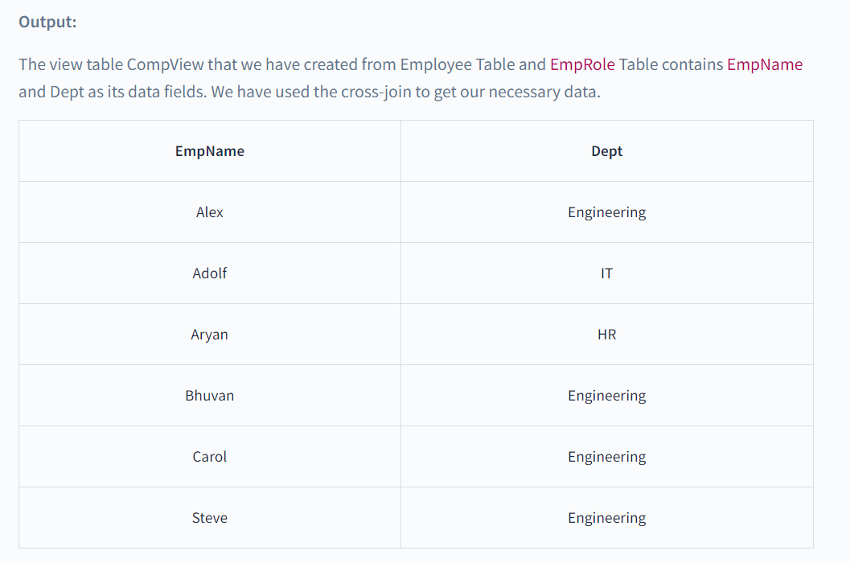

Slide 18
Deleting View in DBMS
Now we know how to create simple and complex views but what if we don't need our created views anymore, So we need to delete the view so as we DROP a table in SQL, similarly, we can delete or drop a view using the DROP statement.
The DROP statement completely deletes the structure of the view.
Syntax: DROP VIEW ViewName;
Here ViewName is the name of the view to be deleted.
Example: Let's delete one of our created views, say EmpView1.
DROP VIEW EmpView1;
Let's use the SELECT statement on Deleted View.
SELECT * from EmpView1;
Output: Now SQL Editor will give us an error saying the table does not exist as the table is now been deleted.
ORA-00942: table or view does not exist

Slide 19
Updating View in DBMS
Suppose we want to add more columns to the created view so we will have to update the view.
For updating the views we can use CREATE OR REPLACE VIEW statement, new columns will replace or get added to the view.
Syntax: CREATE OR REPLACE VIEW ViewName AS SELECT column1,coulmn2,.. FROM TableName WHERE condition;
For Updating a view CREATE OR REPLACE statement is used. Here, viewName is the Name of the view we want to update, tableName is the Name of the table and condition is the Condition by which we select rows.
Example 1: let's take the above created simple view EmpView1 and we want to one more column of address to our EmpView1 from Employee Table.
CREATE OR REPLACE VIEW EmpView1 AS
SELECT EmpID, EmpName, Address FROM Employee;
Now to see the data in the EmpView1 view created by us, We have to simply use the SELECT statement.
SELECT * from EmpView1;

Slide 20
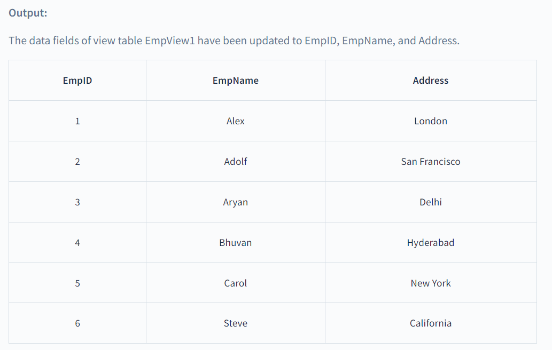

Slide 21
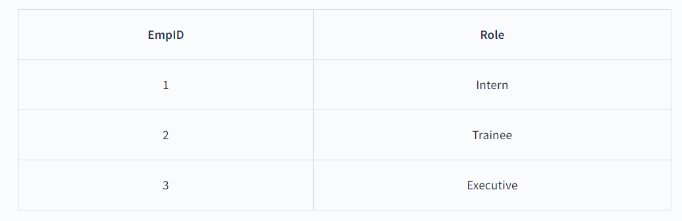
Example 2:
Let's take the above created simple view EmpView2 and we want to replace the Dept column with the Role column.
CREATE OR REPLACE VIEW EmpView2 AS
SELECT EmpID,Role FROM EmpRole WHERE EmpID<4;
Now to see the data in the EmpView2 view created by us, We have to simply use the SELECT statement.
SELECT * from EmpView2;
Output: The fields of view table EmpView2 have been updated to EmpID and Role.

Slide 22
Manipulating Data in a View
Views can also be used to manipulate data in the scope of the view table only, manipulating data in a view does not affect the data of the original table. Updateable Views are views that allow for data manipulation but there are certain conditions needed to be taken care of while manipulating the data of the view:
The GROUP BY and ORDER BY clauses should not be included in the SELECT statement used to generate the view.
The DISTINCT keyword should not be used in the SELECT statement.
All NOT NULL values should be present in the View.
Nested or complex queries should not be used to construct the view.
A single table should be used to generate the view. We would not be able to update the view if it was constructed using several tables.
Manipulating data in a view includes inserting or deleting a row from the view table
Inserting a Row in a View
Inserting a row in the view takes the same syntax as we use to insert a row in a simple table
Syntax: INSERT INTO ViewName(column1, column2,..) VALUES(value1, value2,..);
Here, viewName is the view in which we have to insert data and we add values according to the columns in the view table.
Example: let's take the above created simple view EmpView2 and we want to insert a new row.
INSERT INTO EmpView2(EmpID, Role) VALUES(4, 'Intern');
Now to see the data in the EmpView2, We have to simply use the SELECT statement.

Slide 23
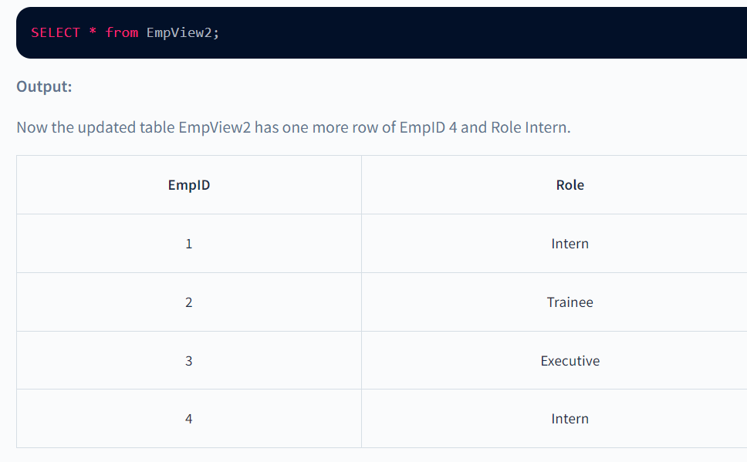

Slide 24
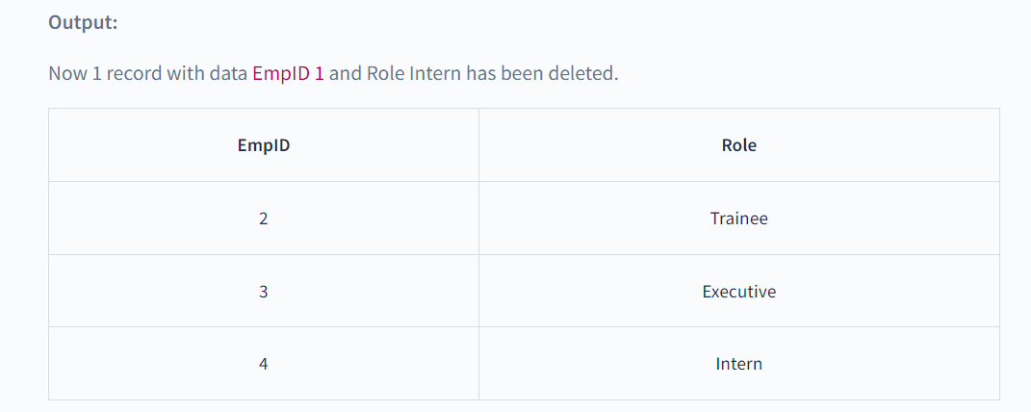
Deleting a Row in a View
Deleting a row in the view takes the same syntax as we use to delete a row in a simple table.
Syntax: DELETE FROM ViewName WHERE condition;
Here, viewName is the view from which data has been deleted, condition is the Condition by which we select rows to be deleted.
Example: let's take the above created simple view EmpView2 and we want to delete the row having EmpID = 1.
DELETE FROM EmpView2 WHERE EmpID = 1;
Now to see the data in the EmpView2, We have to simply use the SELECT statement.
SELECT * from EmpView2;

Slide 25
Points to Remember
Views are some kind of virtual tables created by original tables from the database.
Views actually do not hold the actual data and just have the definition of the original data.
Views act as a proxy or virtual table created from the original table.
The view has two primary purposes:
Simplifying complex SQL queries.
Restricting users from accessing sensitive data.
View can be created by using the CREATE VIEW statement.
Simple view is the view that is made from a single table.
Complex view is the view that is made from multiple tables.
We can delete or drop a view using the DROP statement
For updating the views we can use CREATE OR REPLACE VIEW statement.
Inserting a row in a view follows the same syntax as inserting a row in a plain table.
Deleting a row in the view follows the same syntax as deleting a row in a plain table.

